Slide 1
Bournville Primary School
Communication in the First World War
8th December 2014 Mr D. Smith

Slide 2
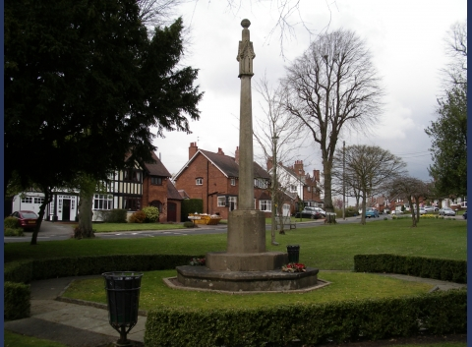
The Bournville War Memorial in Sycamore Road

Slide 3
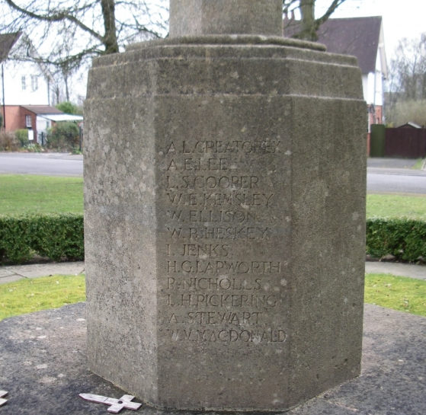
The names

Slide 4
Private Arthur Lloyd Greatorex
Private Albert E Lee
Corporal Lance Leonard Simion Cooper
Private William Edward Kemsley
Sapper Wilfred Ellison
Lance Corporal W B Heskey
Private William Ivor Jefferies Jenks
Gunner Henry George Lapworth
P Nicholls
Lance Corporal Leonard Hugh Pickering
A Stewart,
Private William Victor MacDonald
Corporal Sydney W Leech
Private Frank Bert Cornwell
Private Sidney James Bate
Sapper William Coley
Gunner Frank Hubert Warr
D Thornton
T S Smith,
F A Thompson
S Allton,
I Brittain,
H Harris,
S Smith,
J W White,
H E Shrimpton,
Private H Cashmore
Company Quartermaster Sergeant H J Bracey
Private Robert Henry Crabtree
Private Harold B Fisher
R D Coughtree,
Second Lieutenant Cyril Thornton
Corporal Wallace Austin Hollier
Lance Corporal Sydney George Jones
W H Millington.

Slide 5
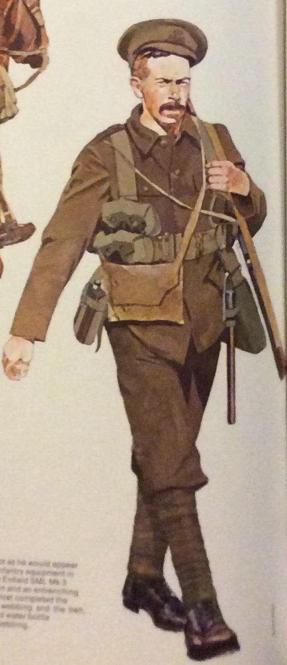
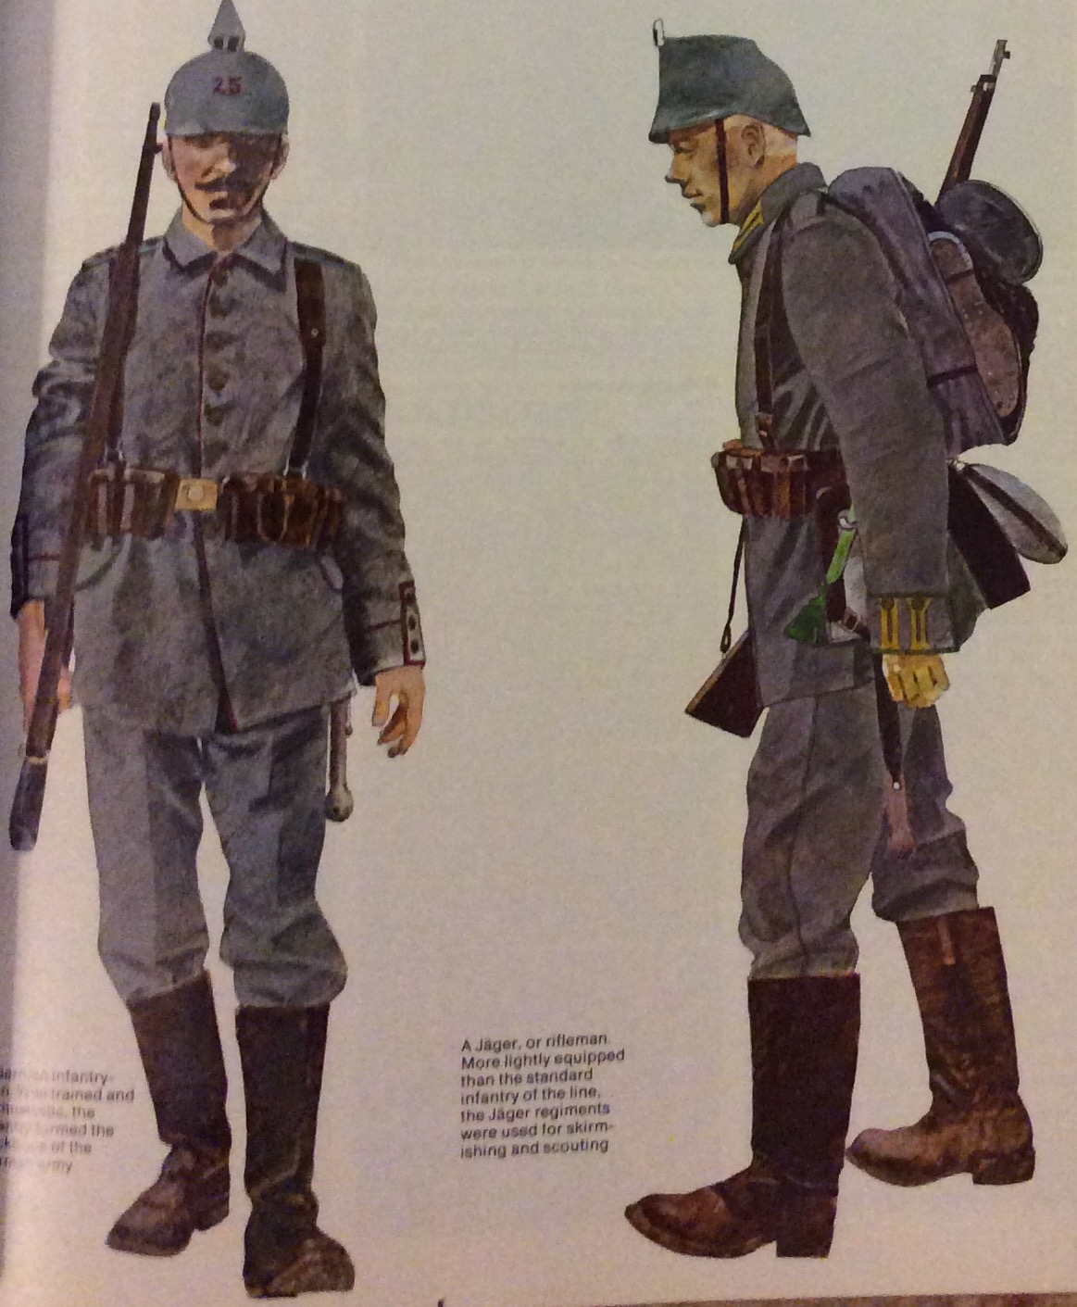
The soldiers

Slide 6
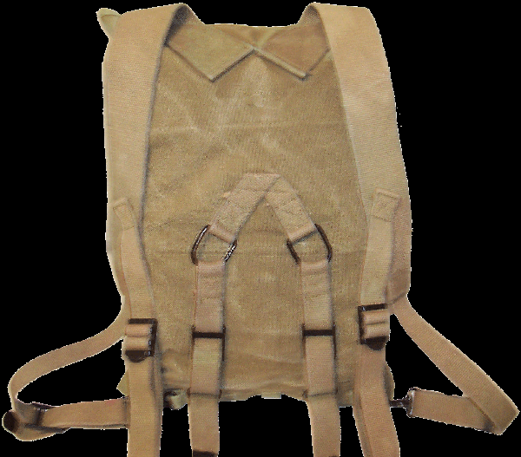
So what’s in my bag?

Slide 7
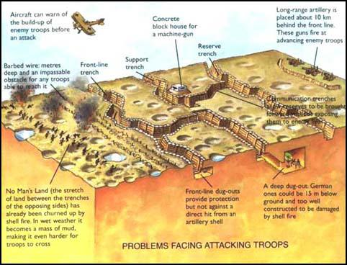
Trench warfare

Slide 8
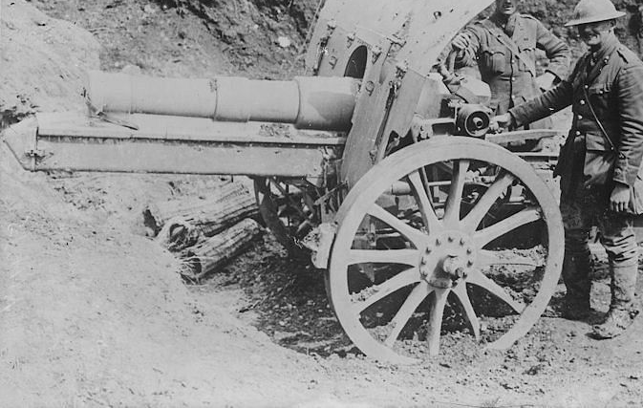
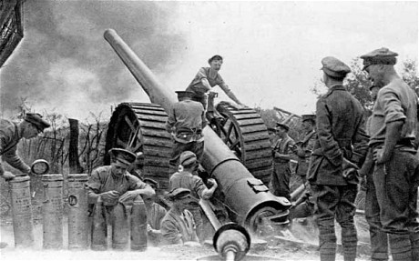
The guns

Slide 9
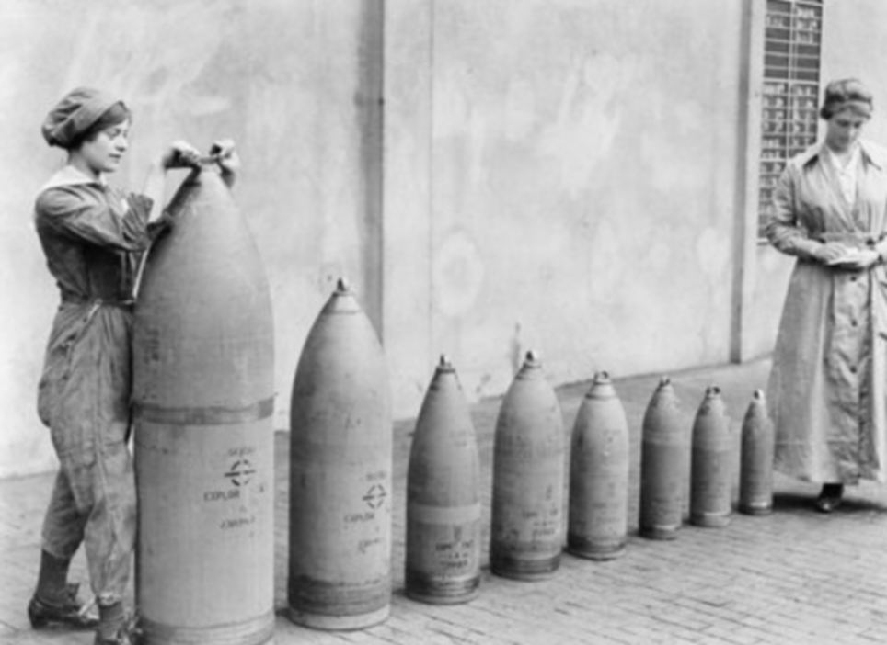
The shells

Slide 10
Different types of shell
Pip squeak – high explosive, high velocity
Whizz bangs – mixed shrapnel and high explosive
Woolly bear – 4.23 inch shell
Coal box – bursts in air, black smoke, shrapnel
Black Maria – 11.2 inch shell. Very black smoke.
Jack Johnsons – 15 inch shell

Slide 11
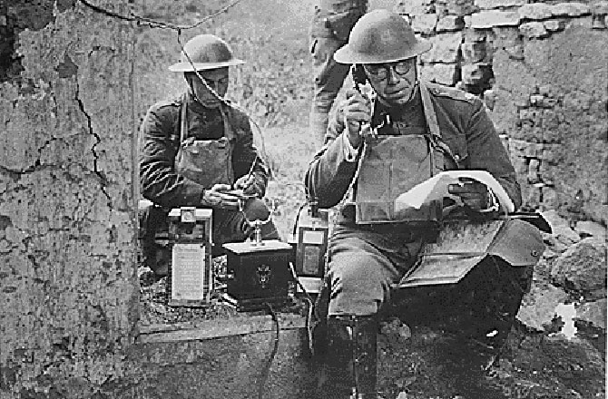
Telephone communication

Slide 12
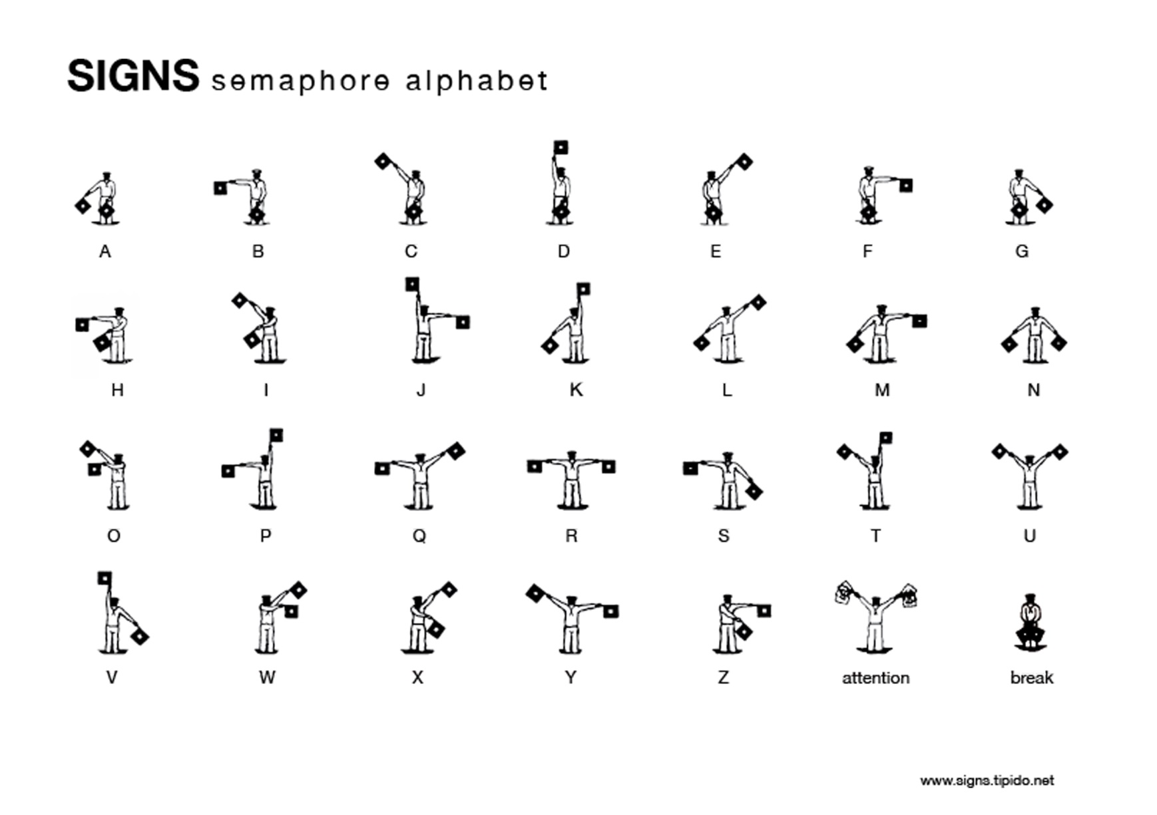
Semaphore

Slide 13
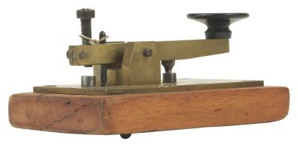
Morse code

Slide 15
?

Slide 16
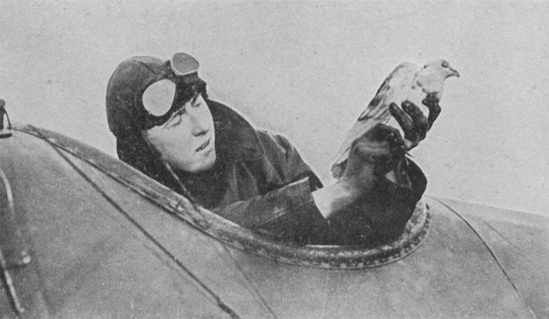
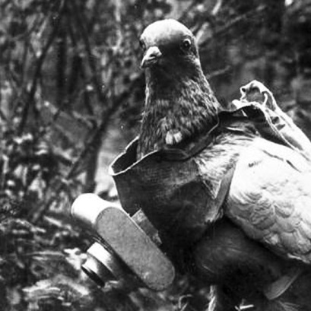
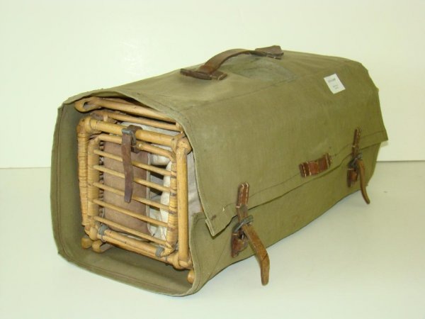
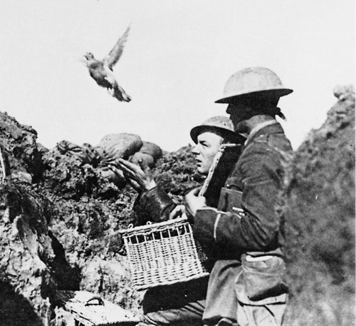
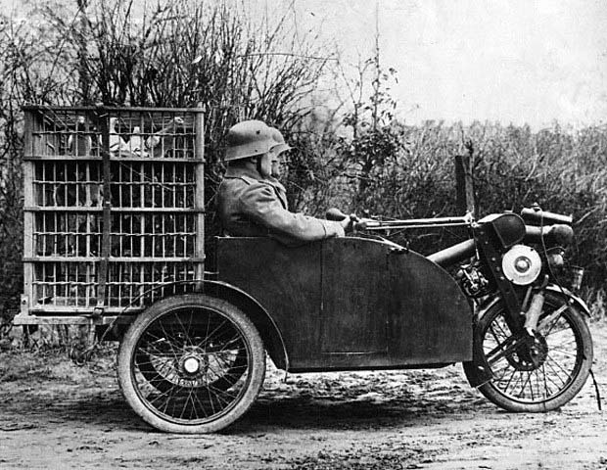
Carrier pigeons

Slide 17
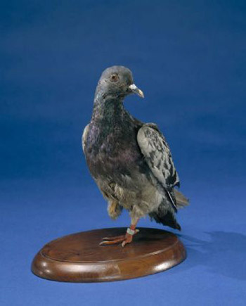
Cher Ami

Slide 18
Cher Ami
On October 3, 1918, a US group of 500 men were trapped in a small depression on the side of the hill behind enemy lines without food or ammunition. They were also beginning to receive friendly fire from allied troops who did not know their location. Surrounded by the Germans, many were killed and wounded in the first day and by the second day, just over 194 men were still alive. Messages were dispatched by pigeon. The pigeon carrying the first message, "Many wounded. We cannot evacuate." was shot down. A second bird was sent with the message, "Men are suffering. Can support be sent?" That pigeon also was shot down. Only one homing pigeon was left: "Cher Ami". She was dispatched with a note in a canister on her left leg. As Cher Ami tried to fly back home, the Germans saw her rising out of the brush and opened fire. For several moments, Cher Ami flew with bullets zipping through the air all around her. Cher Ami was eventually shot down but managed to take flight again. She arrived back at her loft at division headquarters 25 miles to the rear in just 25 minutes, helping to save the lives of the 194 survivors. In this last mission, Cher Ami delivered the message despite having been shot through the breast, blinded in one eye, covered in blood and with a leg hanging only by a tendon. Cher Ami was awarded the Croix de Guerre Medal with a palm Oak Leaf Cluster for her heroic service.

Slide 19
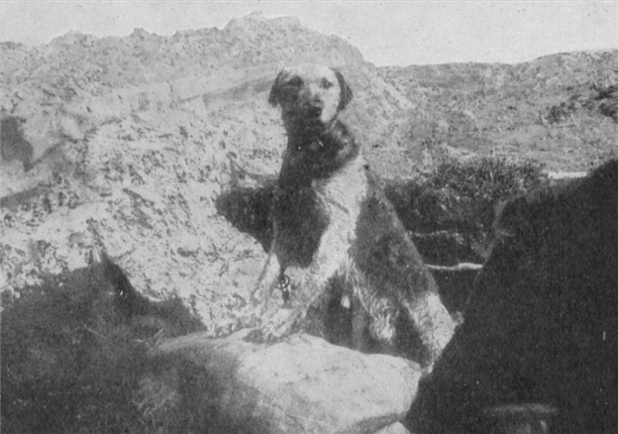
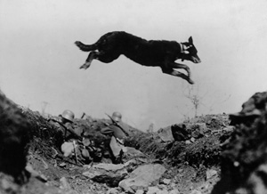
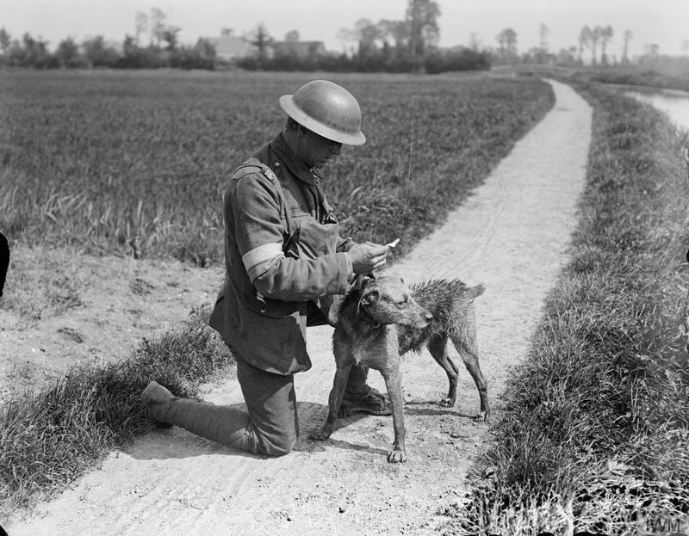
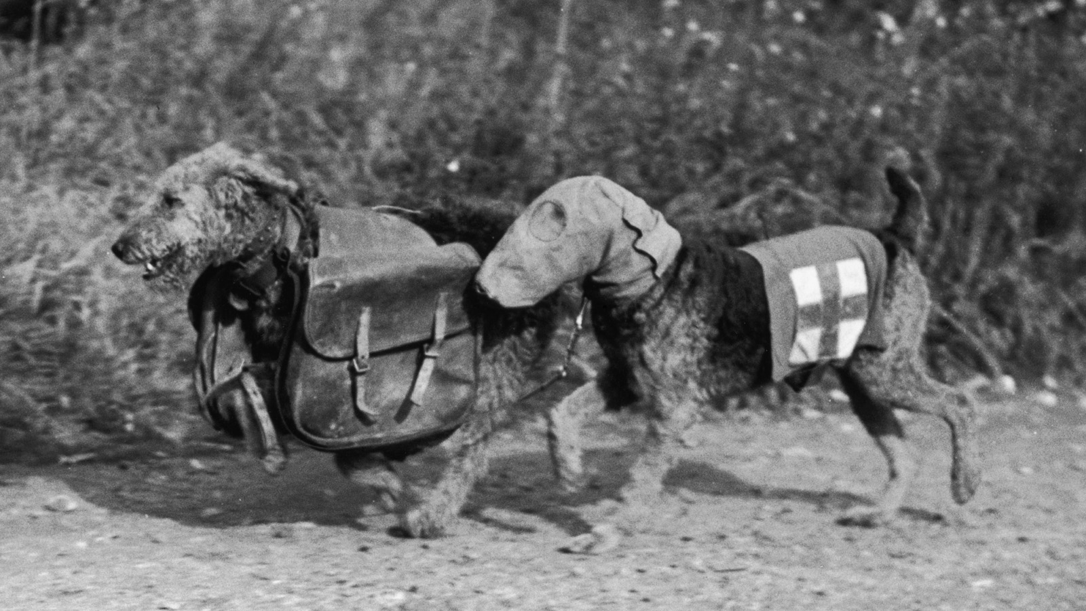
Dogs in the First World War

Slide 20
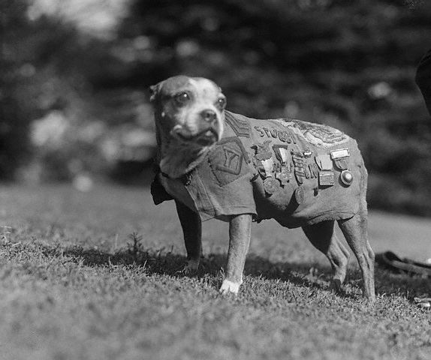
Sergeant Stubby (1916 or 1917- March 16th 1926)

Slide 21
Sergeant Stubby
Stubby‘ was a stray Bull terrier cross, who was found wandering through an army training session in Connecticut. He was befriended by the soldiers and was smuggled on their ship when they were sent to France. Stubby remained with the 102nd Infantry, 26th Division, known as the Yankee division. Having survived gas attacks, he became very sensitive to the smell of gas, and with his sensitive dog nose, was able to detect gas much earlier than his human comrades and alert them in time. His acute doggy hearing, allowed him the advantage of hearing even the quietest sounds from advancing enemy and so Stubby proved excellent at silently alerting his comrades when he could hear the enemy was near. His major triumph was hearing a German spy who had tried to sneak into Conroy's camp during the dead of night. The loyal and diligent Stubby managed to grab the intruder's leg and immobilize him until the US troops came to investigate and imprison the German. He also asserted himself as a 'mercy' dog, scanning the battle fields for injured soldiers and comforting them whilst they lay dying or alerting paramedics to the wounded. He was present at many battles, including at Chateau-Thierry, the Marne and St. Mihiel. Over time, he survived a number of injuries, including those from shrapnel and gas attacks. It is said he became so well-known and admired that he was treated in Red Cross hospitals, as human soldiers. He received more medals than any other soldier dog.

Slide 22
Letters home
Fred Andrews – BEF France – Dear Mother and Floss, I hope you are all quite well, I am all right…I did not have my bottom teeth altered at Salisbury, but I can eat quite well with the top ones. I keep the bottom ones in my pocket. I should not like to lose them.
BEF France – Dear Mum, I have just received two letters from you, and one from Ollie. Thank you very much for your wishes and the ten shillings. I do not want anything for myself, thank you, so will you please have it back…Ollie sent me a birthday card and a letter. There is not a Post Office here and we cannot leave the camp at all. We have cold water for a bath, and hot water for washing. We are going to the school again tonight, to have a night in the trenches. It is a good night for the job. I have got your parcel. Thank you very much, but it must be the last. Please. We get plenty of cheese here. I will close now with Very Best Love, and again Thanking you all very much for everything. Fred xxx (It was his last letter home!)

Slide 23
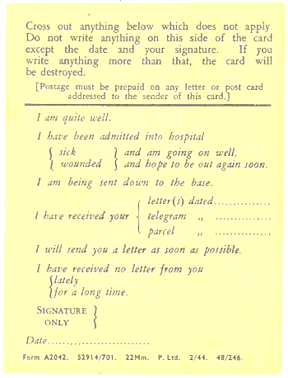
Field Postcard

Slide 24
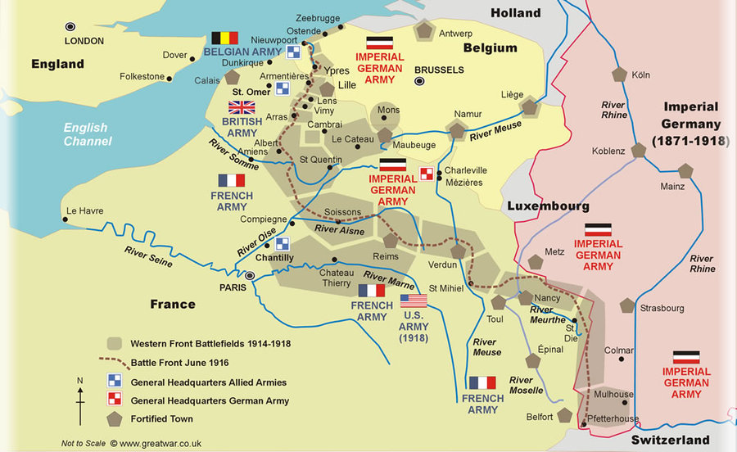
The Bournville War Memorial
The Western Front

Slide 25
Sniping and shell fire
Lance Corporal Leonard Hugh Pickering – 14755 7th Battalion Duke of Cornwall's Light Infantry. He was the son of Oliver F. and Elizabeth Pickering, of 57, Elm Rd., Bourneville, Birmingham. He died aged 19 on 26/08/1915 and is buried in the Brewery Orchard Cemetery, Bois-Grenier.

Slide 26
The Battle of Loos 25th September – 14th October 1915
Private Arthur Lloyd Greatorex – 20062 7th Battalion King's Own (Royal Lancaster Regiment). He was the son of Mr. J. W. Greatorex, of 28, Laburnum Road, Bournville, Birmingham. He died aged 24 on Death:10/10/1915 and is buried in Le Touret Military Cemetery, Richebourg-L'Avoue.

Slide 27
The Battle of the Somme 1st July – 18th November 1916
Private Albert E Lee – 305215 1st/8th Battalion Royal Warwickshire Regiment. He was the son of Alfred and Florence Lee, of 38, Willern Road, Bournville, Birmingham. He died aged 19 on 01/07/1916. He is remembered on the Thiepval Memorial.
Private Robert Henry Crabtree - TF/2353 23rd Battalion Middlesex Regiment. He was the husband of Elizabeth Mary Crabtree, of 45, Elm Rd., Bournville, Birmingham. He died on 15/09/1916 aged 33 and is remembered on the Thiepval Memorial.
Corporal Wallace Austin Hollier –3355 2nd / 6th Battalion Royal Warwickshire Regiment. He was the only son of Austin Henry and Annie Hollier, of 13, Linden Rd., Bournville, Birmingham. He enlisted in October 1914. He died aged 21 on 19/07/1916 and is buried in the Aubers Ridge British Cemetery, Aubers.

Slide 28
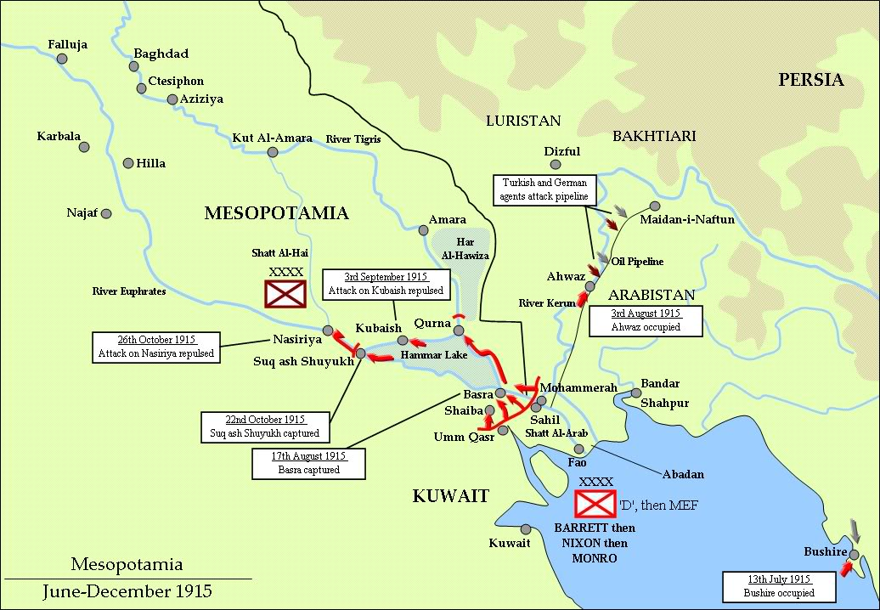
Mesopotamia

Slide 29
The Battle of Khadairi Bend 7th January – 29th January 1917
Private H Cashmore – 14101 9th Battalion Worcestershire Regiment. He was the son of Mrs. Cashmore, of 35, Wallace Rd., Selly Park, Birmingham. He died on 25/01/1917 and is buried in the Amara War Cemetery.

Slide 30
The Battle of Arras 9th April – 16th May 1916
Company Quartermaster Sergeant H J Bracey – 2019 1st Battalion Northumberland Fusiliers who died on 11/04/1917 and is buried in the Faubourg D'Amiens Cemetery, Arras ?
Corporal Lance Leonard Simion Cooper – 1241 14th Battalion (formerly 1st Battalion) Royal Warwickshire Regiment. He was the son of James E.L. and S.A. Cooper, of I, Ridley St., Birmingham. He died aged 25 on 07/05/1917 and is remembered on the Arras Memorial

Slide 31
The Third Battle of Ypres 31st July – 10th November 1917
Gunner Henry George Lapworth – 161605 122 Battery, 52nd Brigade Royal Field Artillery. He was the son of John Joseph Lapworth, of 3, Elm Road, Bournville, Birmingham. He died aged 19 on 30/09/1917 and is buried in the Bedford House Cemetery.
Sapper William Coley – 154905 208th Field Company Royal Engineers. He was the son of William and Elizabeth Coley, of Bournville, Birmingham and husband of Nellie May Coley, of 60, Kingsley Road, King's Norton, Birmingham. He died aged 31 on 22/10/1917 and is buried in the Bard Cottage Cemetery.
Lance Corporal W B Heskey – 40743 4th Battalion Worcestershire Regiment. He was the husband of Jessie Heskey, of Bournville, Birmingham. He died aged 37 on 20/11/1917 and is buried in the Fifteen Ravine British Cemetery, Villers-Plouich.

Slide 32
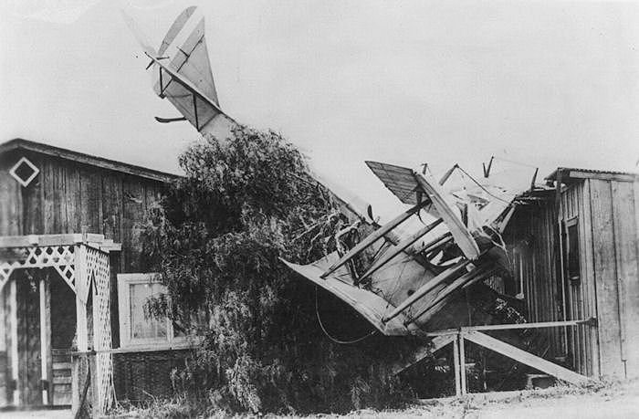
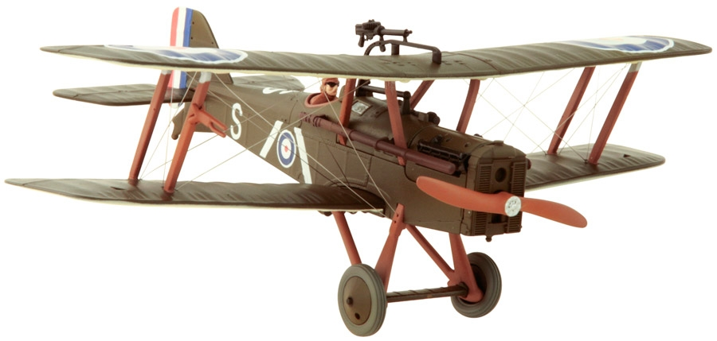
Flying accident
Second Lieutenant Cyril Thornton - Royal Flying Corps. He was the son of Edgar Ernest James and Cecilia Mary Thornton, of 28, Acacia Rd., Bournville, Birmingham. He died on 05/10/1917 aged 18 and is buried in Lodge Hill Cemetery Birmingham

Slide 33
The German Spring Offensive 21st March – 29th April 1918
Private Sidney James Bate – 41707 2nd/4th Battalion Royal Berkshire Regiment. He was the son of James and Sarah Bate, of Rednal and husband of Ruemiah Louise Bate, of 63, Selly Oak Road, Bournville, Birmingham. He died aged 41 on 03/04/1918 and is buried in the Ham British Cemetery, Muille-Villette.
Private Harold B Fisher – 133858 51st Battalion Machine Gun Corps (Infantry). He died on 14/04/1918 and is remembered on the Ploegsteert Memorial?
Private William Victor MacDonald – 41868 2nd Battalion Yorkshire Regiment. He was the son of Mr W. H. and Mrs H. MacDonald, of 288, Selly Oak Road, King's Norton, Birmingham. He died aged 20 on 08/05/1918 and is remembered on the Tyne Cot Memorial.
Private William Ivor Jefferies Jenks – 1626 16th Battalion Royal Warwickshire Regiment. He was the son of William and Annie Jenks, of Bournville, Birmingham. He died aged 18 on 14/05/1918 and is buried in the Aire Communal Cemetery.

Slide 34
Battle of Cantigny 28th May 1918
Private Frank Bert Cornwell – 73901 1st Battalion Sherwood Foresters (Notts and Derby Regiment). He died on 27/05/1918 and is remembered on the Soissons Memorial.
Lance Corporal Sydney George Jones - T4/198191 41st Division Train, Royal Army Service Corps. He was the son of Thomas Henry and Mary Ann Jones, of Bournville, Birmingham; husband of Elsie Violet Jones, of 14, Victoria Road, Stirchley, Birmingham. He died aged 29 on 29/05/1918 and is buried in the Nine Elms British Cemetery.

Slide 35
Mesapotamia
Sapper Wilfred Ellison – 195644 Royal Engineers Inland Water Transport. He was the son of Thomas and Mary Ann Ellison, of Bradford, Yorkshire and husband of Clara Ellison, of 27, Elm Road, Bournville, Birmingham. He died aged 38 on 02/07/1918 and is buried in the Basra War Cemetery.

Slide 36
Battle of Amiens 8th – 12th August 1918
Corporal Sydney W Leech – 14898 Royal Berkshire Regiment Depot. He was the son of Mrs. E. Leech, of 9, Selly Oak Road, Bournville, Birmingham. He died aged 22 on 22/08/1918 and is buried in Lodge Hill Cemetery, Birmingham.

Slide 37
Battle of Cambrai 8th – 10th October 1918
Private William Edward Kemsley – 242608 ‘C’ Company 1st/8th Battalion Worcestershire Regiment. He was the son of George and Agnes Eliza Kemsley, of Sittingbourne and husband of Grace Lilian Kemsley, of High Street, Upper Upnor, Rochester. He died aged 32 on 06/10/1918 and is buried in the Doingt Communal Cemetery Extension.

Slide 38
Gunner Frank Hubert Warr – 152936 544th Siege Battery Royal Garrison Artillery. He was the son of J. H. and M. Warr and husband of Annie Warr, of 25, Linden Road, Bournville, Birmingham. He died aged 34 on 21/02/1919 and is buried in the Dunkirk Town Cemetery.

Slide 39
And I couldn’t find these!
P Nicholls
A Stewart,
D Thornton
T S Smith,
F A Thompson
S Allton,
I Brittain,
H Harris,
S Smith,
J W White,
H E Shrimpton
R D Coughtree
W H Millington.

Slide 40
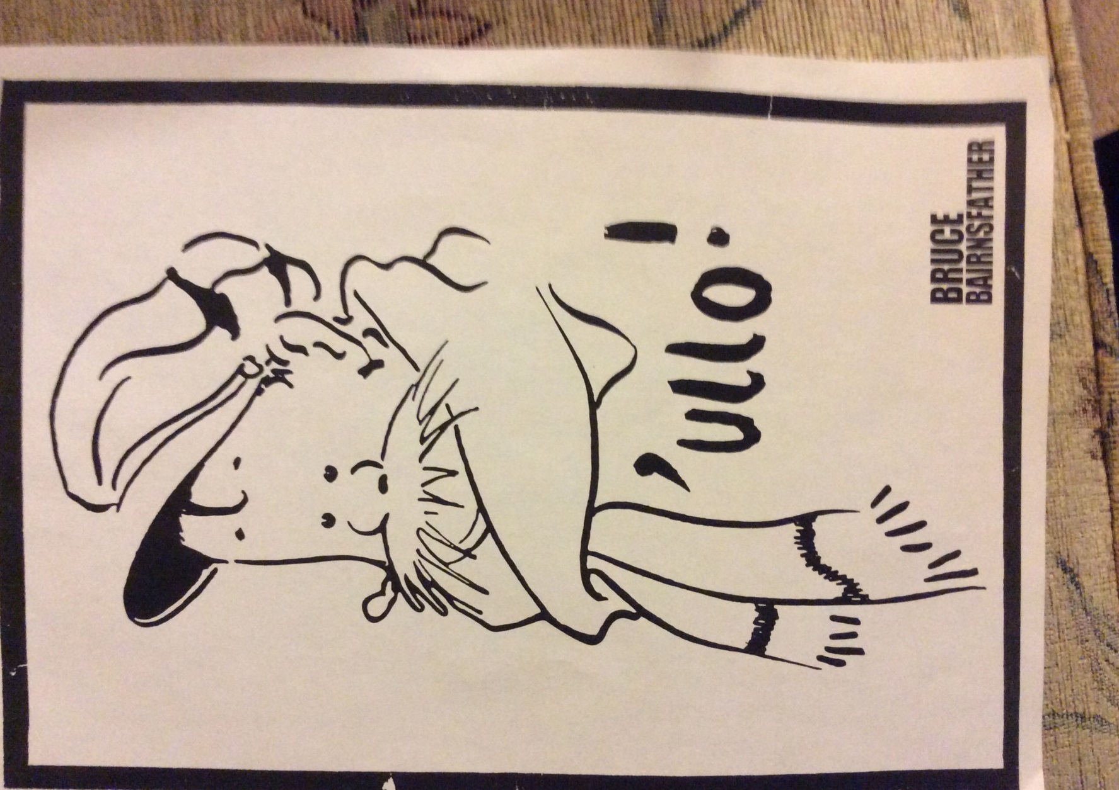
Postcards

Slide 41
